Slide 1
Medical Cost
Katayoon Mehr
Metro College of Technology
Feb 2020

Slide 2
Dataset and preparation: The dataset of insurance contains 10 columns. ID, age, sex, bmi of 1380 patients, whether they have partner or children, if they are smoker, the region they live, and hospital charges as dependent variable. Age has 18, smoker 32 and charges 15 missing values. mean is used to replace age missing values, “unknown” to replace smoker missing values and the 15 rows including missing values of y=charges are dropped. After cleaning we have 1365 rows of data. Encoding on categorical variables, sex with 2 levels male=1, female=2, , partner with 2 levels yes=1, no=0, smoker with 3 levels unknown=0, no=1, yes=2 and region with 4 levels northeast=1, northwest=2, southeast=3 and southwest=4 is done.
ID | age | sex | bmi | children | smoker | region | charges | partner | sex_C | smoker_C | region_C | partner_C
10001 | 27 | female | 31.4 | 0 | yes | southwest | 34838.873 | yes | 2 | 2 | 4 | 1
10002 | 39 | female | 39.71 | 0 | yes | northeast | 13143.337 | no | 2 | 2 | 1 | 0
10006 | 23 | female | 28.31 | 0 | yes | northwest | 18033.968 | no | 2 | 2 | 2 | 0

Slide 3
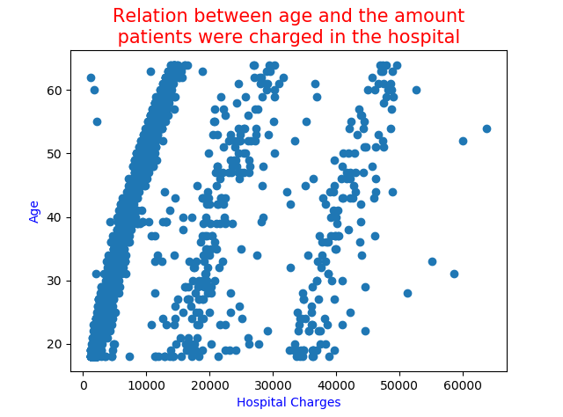
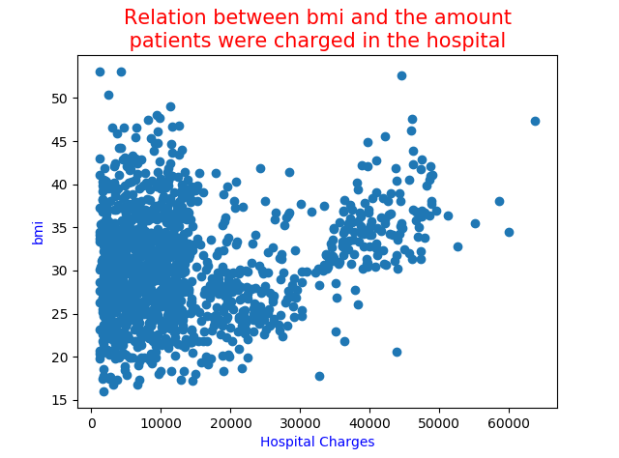
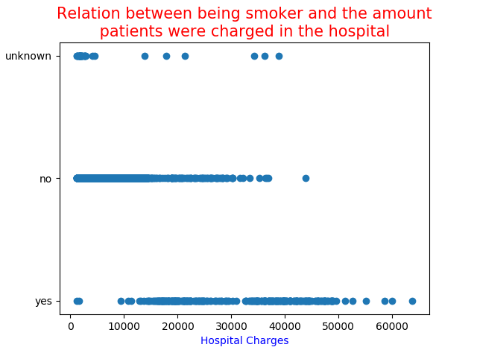
Correlation and association between variables:
As the age increases, the amount of charges also increases.
For the amount of less than 10,000, bmi doesn’t show a specific association with charges, but as the amount increases, patients tend to have higher bmi. Smoker patients have a bigger variation over their hospital charges and the highest charges belong to smokers.

Slide 4
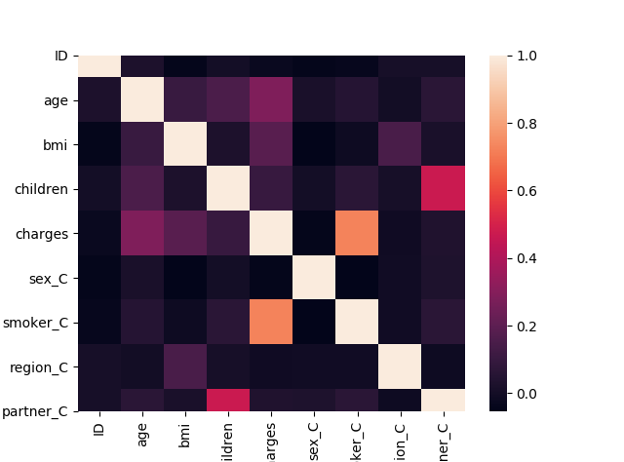
Correlation and association between variables:
Being smoker and the amount of charges has the highest correlation.
Also number of children and having a partner is correlated.
 | ID | age | bmi | children | charges | sex_C | smoker_C | region_C | partner_C
ID | 1
age | 0.0250 | 1.0000
bmi | -0.0423 | 0.1061 | 1
children | 0.0037 | 0.1525 | 0.0273 | 1
charges | -0.0249 | 0.2873 | 0.1859 | 0.1006 | 1
sex_C | -0.0417 | 0.0194 | -0.0500 | 0.0012 | -0.0447 | 1
smoker_C | -0.0363 | 0.0517 | -0.0151 | 0.0626 | 0.7244 | -0.0533 | 1
region_C | 0.0110 | -0.0011 | 0.1520 | 0.0100 | -0.0082 | -0.0055 | -0.0058 | 1
partner_C | 0.0091 | 0.0642 | 0.0202 | 0.4705 | 0.0335 | 0.0326 | 0.0633 | -0.0155 | 1

Slide 5
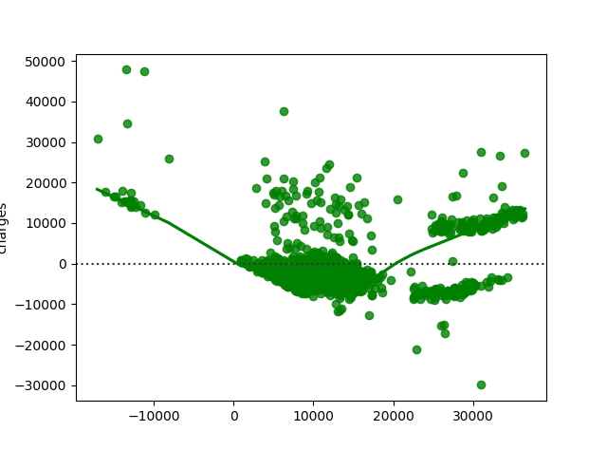
Linear Regression Model:
X = [age, bmi, children, sex, smoker, region, partner]
y = charges
y = -26562.1157 + 200.596 age + 335.825 bmi +
384.039 children - 44.8978 sex_C + 19319.8 smoker_C –
376.116 region_C - 1133.59 partner_C
R2 (Train)= 0.6043 R2 (Test)=0.6621
Children has the highest pvalue
which makes it insignificant and the next
insignificant X is bmi.
y = -17126.4998 + 221.689 age - 276.906 sex_C + 19300.7 smoker_C - 135.451 region_C - 709.801 partner_C
X | P-Value
age | 0.00000
bmi | 0.05781
children | 0.10144
sex_C | 0.00000
smoker_C | 0.00000
region_C | 0.00000
partner_C | 0.00364
X | P-Value
age | 0.00000
bmi | 0.06097
sex_C | 0.00000
smoker_C | 0.00000
region_C | 0.00000
partner_C | 0.01513
X | P-Value
age | 0.00000
sex_C | 0.00000
smoker_C | 0.00000
region_C | 0.00000
partner_C | 0.01021

Slide 6

Cross Validation:
With 1365, 5-fold regressions were developed to check the validation on the model. The values are 0.6272, 0.5068 , 0.6075, 0.5257, 0.6265 with average of 0.5787.
R-Square from final test model is 0.6442.
R2-Adj= 0.6481

Slide 7
The end thank you

